Slide 1
SP 473 Drainage Review
A
Begin Project
B
End Project
June 22, 2016

Slide 2
Outline
Project Site
Existing Conditions
Hydrology
Hydraulics
Pros vs Cons

Slide 3
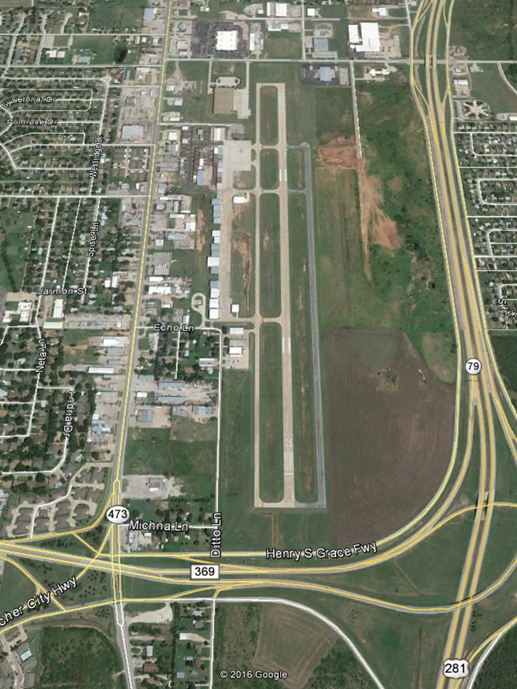
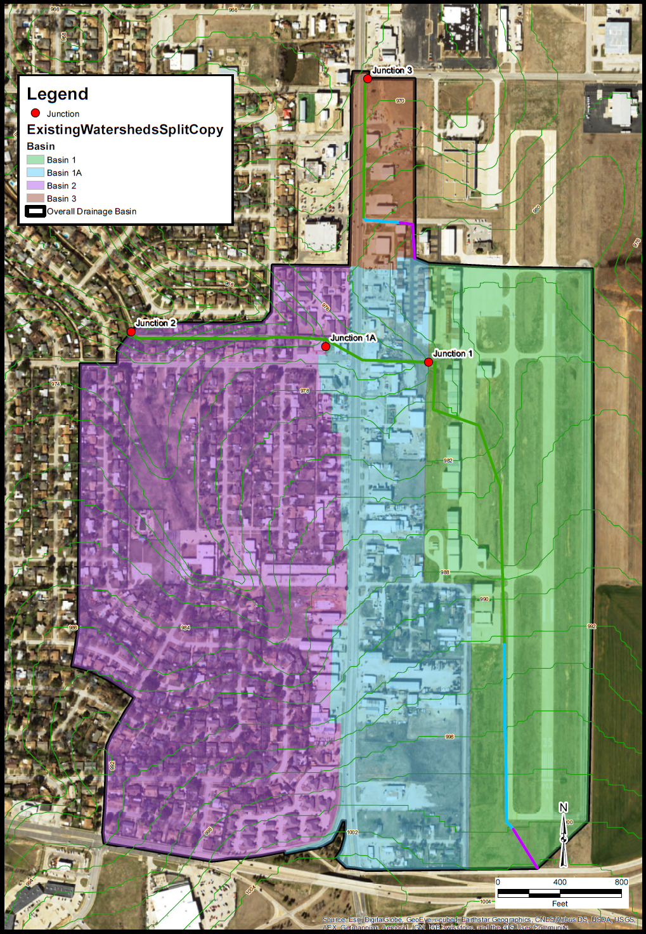
Project Site
End
Project
A
D
Storm Drain Outfall
C
Channel Outfall
Contributing Drainage Areas
B
Begin Project

Slide 4
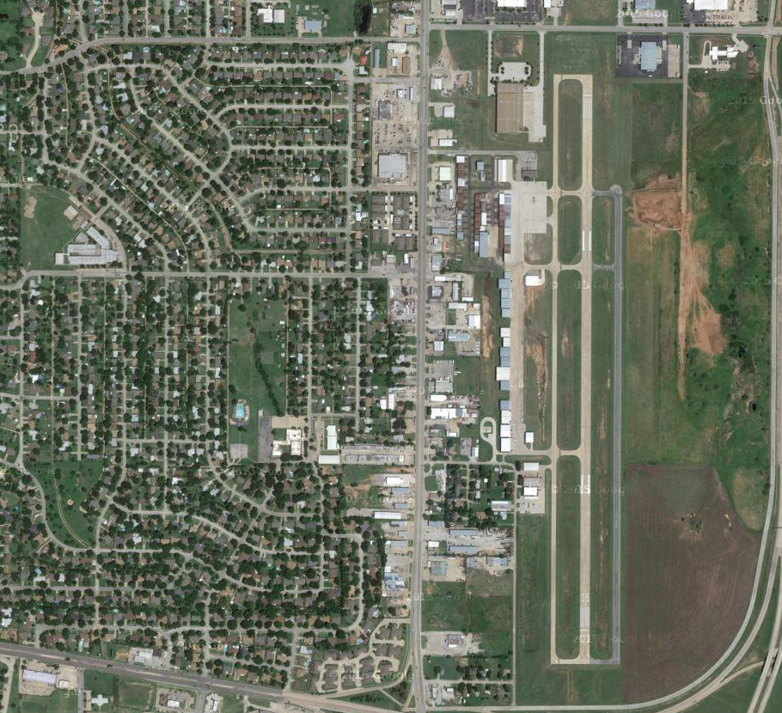
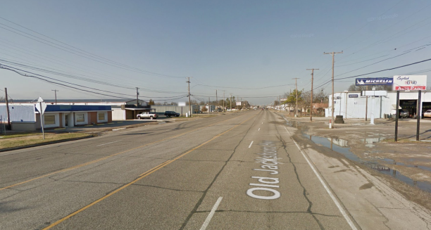
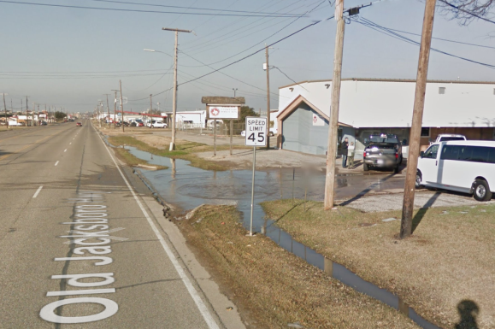
Existing Conditions
Existing Storm Drain
Drainage Area Divide
Existing Channel
Airport Detention Basin
Driveway Ponding

Slide 5
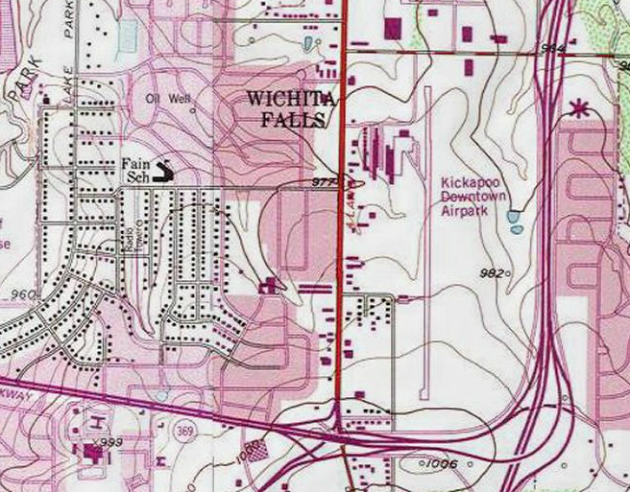
Hydrology
Existing channelized flow

Slide 6
Hydrology
XX acres
Place table from report showing flow rates
XX acres
XX acres
XX acres

Slide 7
Hydrology
Show FEMA map here is discuss prop and exist flow rates

Slide 8
Hydraulics

Slide 9
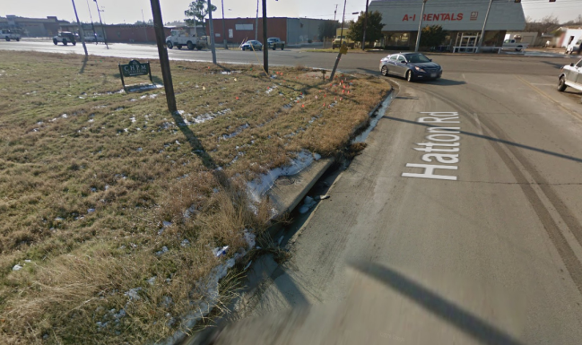
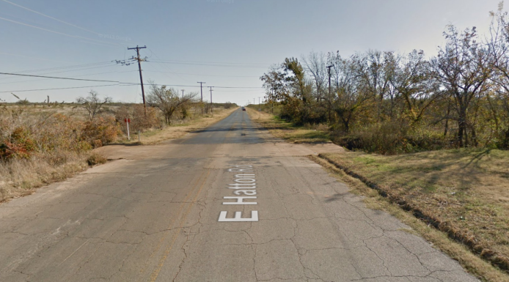
Hydraulics
Existing Storm Drain Details

Slide 10
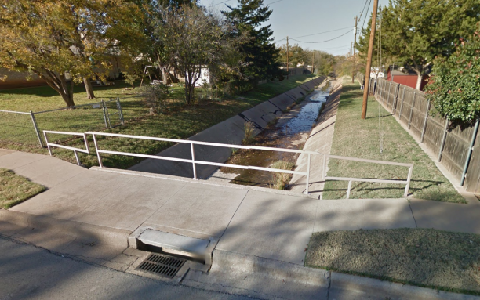
Hydraulics
Design Considerations
  Non Exiting Sags
  Frequency
  Outfalls

Slide 11
Hydraulics
Proposed System
  Options
  Limitations
  Frequency
Nonconsecutive Curb
Partial Storm Drain System
Ponding
Slow water conveyance
Storm Drain System
Curb & Gutter
Swales
Existing
Issues
Proposed

Slide 12
Hydraulics

Slide 13
Pros vs Cons

Slide 14
Pros vs Cons
Bullet 1 (22pt)
  Sub bullet 1 – only the first letter of the statement is capitalized (20pt)
    third level (20pt)
Bullet 2
Bullet 3
  Sub bullet 1 – only the first letter of the statement is capitalized
    third level

Slide 15
Pros vs Cons

Slide 16
Client Name or Audience (20pt)

